Slide 1

Welcome to the Leadership for Safety Webinar
Safety Attitude Questionnaire:
Unit-Level Results on Teamwork and Non-Punitive Response to Error
The webinar will be starting momentarily…
If you are having technical difficulties please contact 202-495-3356 or ltiscornia@naph.org

Slide 2
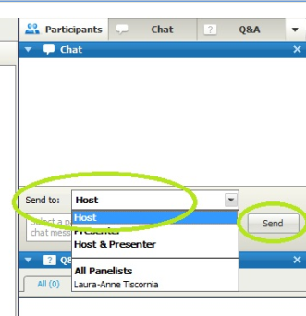
Chat Box
Please use the Chat Box on the webinar screen to type your question or comment at any time.
NOW: Use the Chat Box to sign in. Enter your organization and names of all people in the room.

Slide 3
Agenda for Today’s Webinar
Unit-level COS results from San Francisco General Hospital, and UT Tyler
Unit by unit COS data, resilience, and readiness for change
Run chart “poster session”
Next month’s focus: Just Culture – How to know whether to hold an individual to account for a safety mishap.

Slide 4

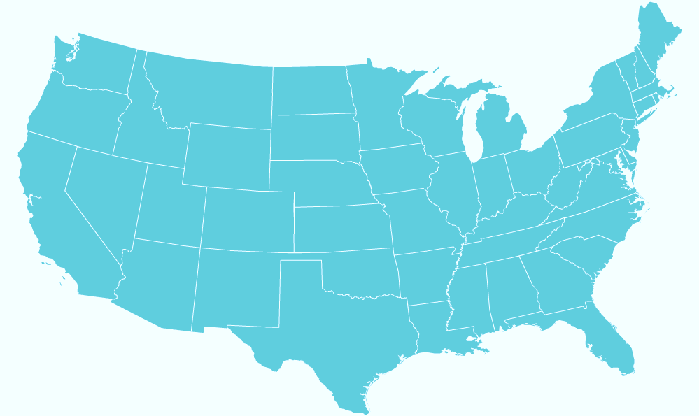
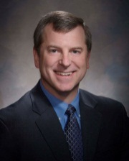
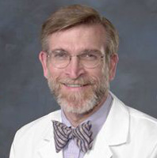
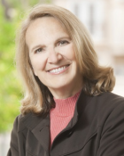
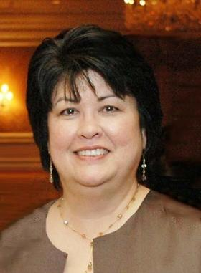
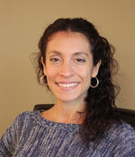
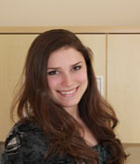
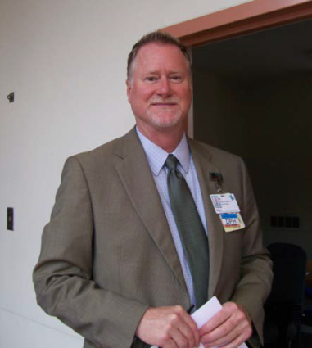
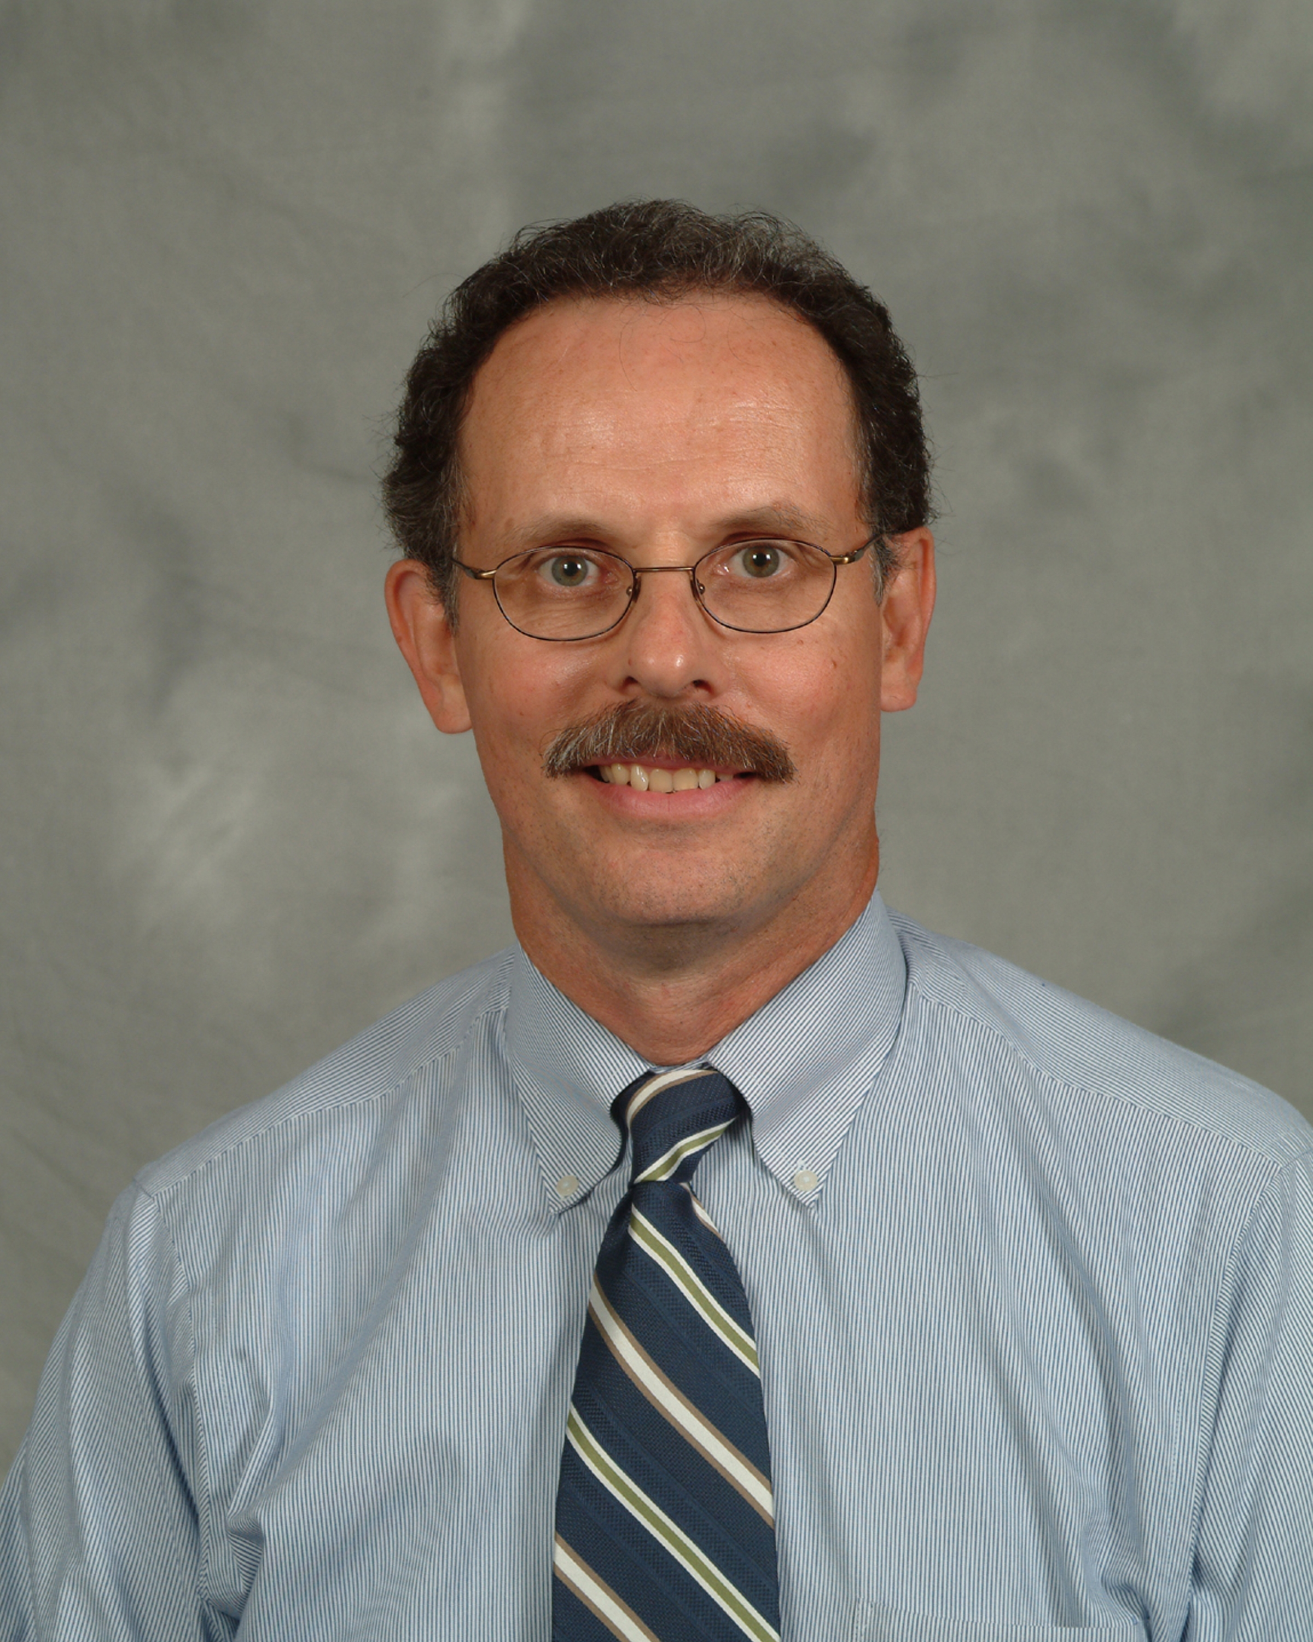
Who is on Today’s Call?
Jim Reinertsen, MD
Bart Hill, MD, MPA
St. Luke’s Treasure Valley
Alfred Connors, MD
Jill Steinbruegge, MD, PhD
St. Luke’s Regional Medical Center
Sue Currin, MS, RN
St. Luke’s Meridian Medical Center
Cook County Health & Hospitals System
MetroHealth
San Francisco General Hospital and Trauma Center
John H. Stroger, Jr. Hospital
Provident Hospital
Contra Costa Regional Med. Center
Alameda County Medical Center
Santa Clara Valley Health and Hospital System
Truman Medical Centers
San Mateo Medical Center
TMC- Hospital Hill
TMC- Lakewood
Bianca Perez, PhD
Regional Medical Center at Memphis
Kimberly Horton, DHA, MSN, FNP, RN, FACHE
Los Angeles County Department of Health Services
Harbor-UCLA Med Center LAC+USC Healthcare Network
Rancho Los Amigos National Rehab. Center
Maricopa Medical Center
UT-Health Science Center at Tyler
Univ. Medical Center of El Paso
LSU-HCSD
Arielle Gorstein
Harris County Health System
Interim
Bogalusa
Ben Taub General
LBJ Hospital
Quentin Mease
Leadership Summit staff
Thomas Holton, MS, RN
David Coultas, MD, FACP
Guest speakers on today’s call

Slide 5
University of Texas – Tyler
Comparative Results By Unit
Teamwork Across Units |  | Unit 1 2012 | Unit 1 2010 | Difference | Unit 2 2012 | Unit 2 2010 | Difference | Unit 3 2012 | Unit 3 2010 | Difference | Unit 4 2012 | Unit 4 2010 | Difference | Unit 5 2012 | Unit 5 2010 | Difference
1. Hospital units do not coordinate well with each other. | Database | 36 | 36 |  | 43 | 39 |  | 44 | 43 |  | 48 | 46 |  | 41 | 39
 | Your Hospital | 33 | 45 | -12 | 33 | 55 | -22 | 35 | 14 | 21 | 100 | 60 | 40 | 75 | 65 | 10
2. There is good cooperation among hospital units that need to work together. | Database | 48 | 46 |  | 57 | 53 |  | 58 | 56 |  | 63 | 60 |  | 55 | 54
 | Your Hospital | 33 | 55 | -22 | 56 | 64 | -8 | 50 | 43 | 7 | 80 | 80 | 0 | 75 | 52 | 23
3. It is often unpleasant to work with staff from other hospital units. | Database | 50 | 49 |  | 63 | 62 |  | 61 | 60 |  | 64 | 64 |  | 56 | 55
 | Your Hospital | 58 | 45 | 13 | 75 | 73 | 2 | 47 | 53 | -6 | 80 | 80 | 0 | 92 | 71 | 21
4. Hospital units work well together to provide the best care for patients. | Database | 58 | 56 |  | 66 | 63 |  | 66 | 65 |  | 71 | 69 |  | 65 | 63
 | Your Hospital | 58 | 64 | -6 | 63 | 36 | 27 | 57 | 47 | 10 | 100 | 100 | 0 | 92 | 62 | 30
Teamwork Within Units |  | Unit 1 2012 | Unit 1 2010 | Difference | Unit 2 2012 | Unit 2 2010 | Difference | Unit 3 2012 | Unit 3 2010 | Difference | Unit 4 2012 | Unit 4 2010 | Difference | Unit 5 2012 | Unit 5 2010 | Difference
1. People support one another in this unit. | Database | 84 | 84 |  | 89 | 89 |  | 85 | 84 |  | 92 | 92 |  | 83 | 83
 | Your Hospital | 92 | 73 | 19 | 100 | 100 | 0 | 82 | 81 | 1 | 100 | 100 | 0 | 100 | 78 | 22
2. When a lot of work needs to be done quickly, we work together as a team to get the work done. | Database | 86 | 86 |  | 90 | 90 |  | 81 | 81 |  | 90 | 89 |  | 86 | 86
 | Your Hospital | 85 | 73 | 12 | 100 | 100 | 0 | 85 | 75 | 10 | 100 | 100 | 0 | 100 | 87 | 13
3. In this unit, people treat each other with respect. | Database | 74 | 74 |  | 80 | 80 |  | 77 | 76 |  | 88 | 87 |  | 73 | 73
 | Your Hospital | 77 | 50 | 27 | 100 | 100 | 0 | 85 | 75 | 10 | 100 | 100 | 0 | 100 | 74 | 26
4. When one area in this unit gets really busy, others help out. | Database | 67 | 67 |  | 77 | 77 |  | 64 | 62 |  | 77 | 75 |  | 65 | 65
 | Your Hospital | 69 | 36 | 33 | 67 | 67 | 0 | 52 | 56 | -4 | 100 | 100 | 0 | 100 | 52 | 48
Nonpunitive Response to Error |  | Unit 1 2012 | Unit 1 2010 | Difference | Unit 2 2012 | Unit 2 2010 | Difference | Unit 3 2012 | Unit 3 2010 | Difference | Unit 4 2012 | Unit 4 2010 | Difference | Unit 5 2012 | Unit 5 2010 | Difference
1. Staff feel like their mistakes are held against them. | Database | 43 | 43 |  | 46 | 46 |  | 46 | 46 |  | 64 | 64 |  | 48 | 49
 | Your Hospital | 58 | 36 | 22 | 33 | 45 | -12 | 38 | 25 | 13 | 80 | 100 | -20 | 50 | 39 | 11
2. When an event is reported, it feels like the person is being written up, not the problem. | Database | 38 | 38 |  | 43 | 41 |  | 44 | 42 |  | 62 | 61 |  | 46 | 46
 | Your Hospital | 62 | 36 | 26 | 33 | 27 | 6 | 45 | 6 | 39 | 40 | 60 | -20 | 50 | 43 | 7
3. Staff worry that mistakes they make are kept in their personnel file. | Database | 28 | 27 |  | 31 | 30 |  | 32 | 31 |  | 52 | 50 |  | 35 | 34
 | Your Hospital | 31 | 36 | -5 | 25 | 18 | 7 | 15 | 6 | 9 | 80 | 20 | 60 | 42 | 48 | -6

Slide 6
Unit by Unit COS data, Resilience, and Readiness for Change

Slide 7
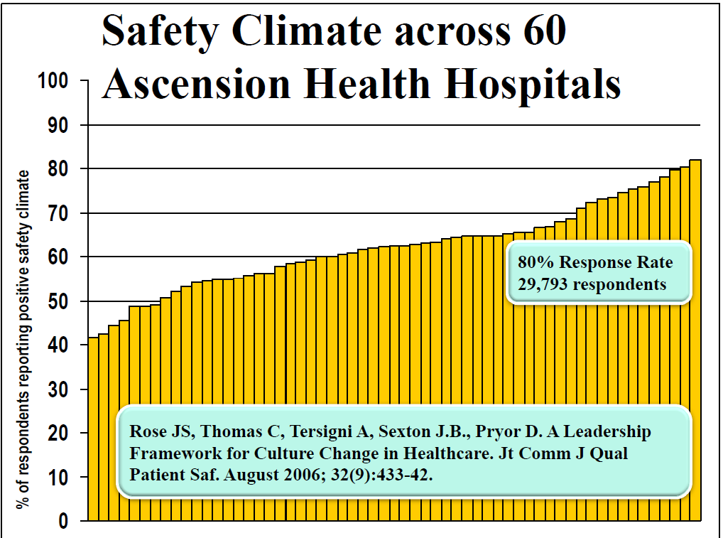

Slide 8
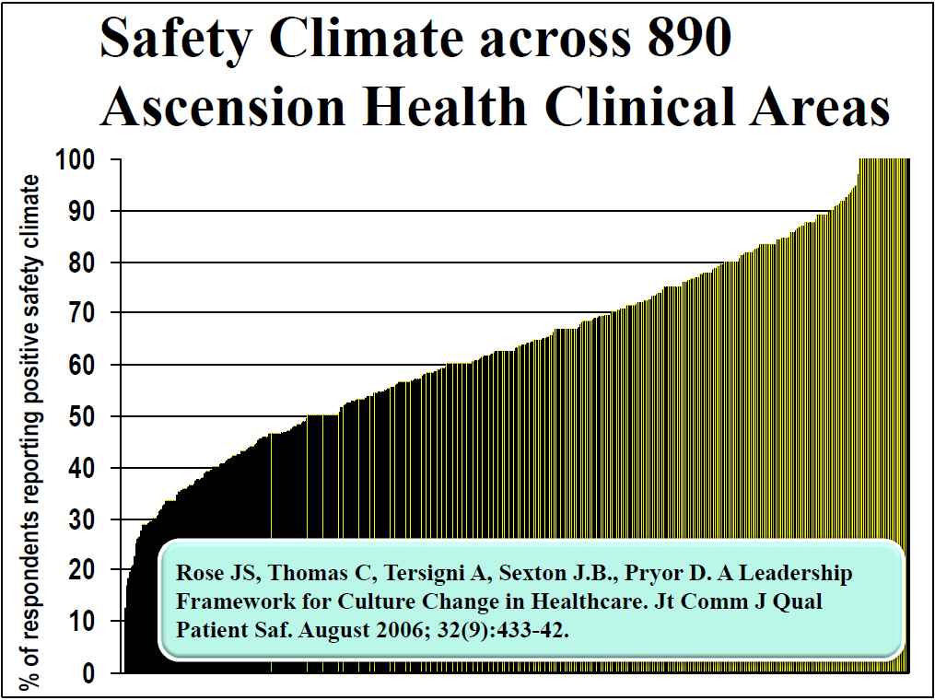

Slide 9
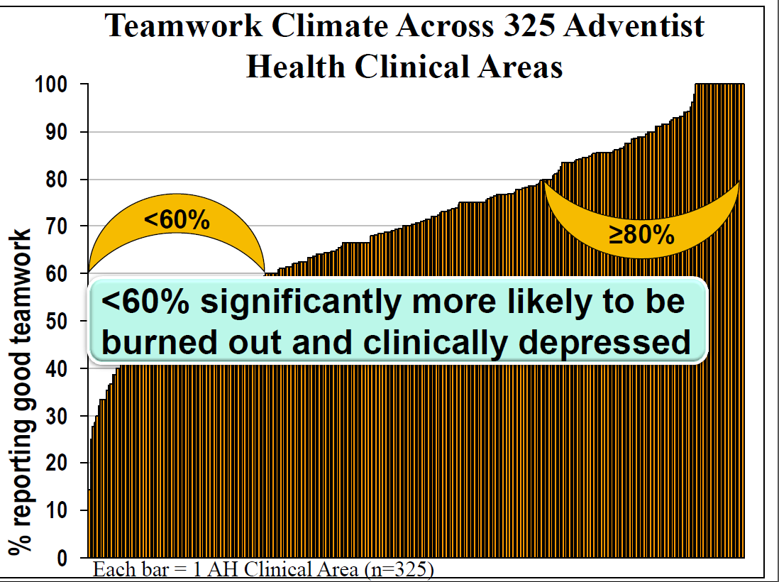
From Bryan Sexton

Slide 10
Key Domain One: Teamwork
Driven by Answers to Six Questions
Nurse input is well received in this clinical area.
In this clinical area, it is difficult to speak up if I perceive a problem with patient care.
Disagreements in this clinical area are resolved appropriately (i.e., not who is right, but what is best for the patient).
I have the support I need from other personnel to care for patients.
It is easy for personnel here to ask questions when there is something that they do not understand.
The physicians and nurses here work together as a well-coordinated team.

Slide 11
A poor teamwork score (less than 60% reporting positive teamwork)…
Results from persistent interpersonal dysfunction on the unit
Predicts operational outcomes e.g. staff turnover, delays, etc.
Needs a specific leadership response: If teamwork score is low, find out which of the questions is dragging the score down and address that issue specifically

Slide 12
Key Domain Two: Safety Climate
Determined by scores on seven questions:
I would feel safe being treated here as a patient.
Medical errors are handled appropriately in this clinical area.
I know the proper channels to direct questions regarding patient safety in this clinical area.
I receive appropriate feedback about my performance.
In this clinical area, it is difficult to discuss errors.
I am encouraged by my colleagues to report any patient safety concerns I may have.
The culture in this clinical area makes it easy to learn from the errors of others.

Slide 13
Poor safety climate scores (<60%)…
Predict poor clinical outcomes, and high staff injury rates
Result from perceived lack of commitment to safety by leadership
Leadership response: demonstrate eagerness to learn about safety problems, and willingness to do something about them

Slide 14
Key Support Domain: Resilience (Burnout)
Determined by scores on four questions:
I feel fatigued when I get up in the morning and a have to face another day on the job
I feel burned out from my work
I feel frustrated by my job
I feel I am working too hard on my job
Leadership Response:
For units with HIGH resilience, you can go ahead with a new initiative even if safety or teamwork scores are low (but you will need to address the specifics of why these scores are low)
For units with low resilience AND low teamwork/safety climate scores, you must first deal with the burnout issues before you can hope to accomplish ANY change initiative.

Slide 15
The MetroHealth System
Run charts for 2010, 2011, 2012 for VAP, CLBSI, and CAUTI

Slide 16
16

Slide 17
17

Slide 18
18

Slide 19
19

Slide 20
20

Slide 21
21

Slide 23
23

Slide 24
Next Month: Tuesday February 12th 8am PT/9am MT/10am CT/ 11am ET
Just Culture
Have a brief conversation with the chief nurse, or the head of HR, and ask the following questions:
Did we initiate disciplinary action against any staff member (nurse, pharmacist, physician, nursing assistant…) because of a safety mishap in the last year?
If yes…by what method did we decide that this was a problem with the individual? What is our method for determining individual culpability for safety mishaps?
Be prepared to discuss what you’ve learned about your organization and how it decides when to hold people to account for their safety behaviors.
Just Culture Algorithm, HR protocols, or other document

Slide 25
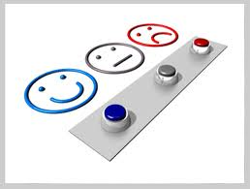
THANK YOU FOR JOINING US!
Monthly webinars are scheduled through March…Tell us if you’d like to continue!
Feedback survey can be accessed in chat box.

